Slide 1
Chapter Five: Market structure
Introduction
This chapter focuses on how the seller makes a decision to achieve its profit maximization objectives.
A firm’s decision to achieve this goal is depending on the type of market in which it operates.
5.1. The concept of market in physical and digital space
Market
Is the process of exchanging goods and services.
A place or digital space by which goods, services and ideas are exchanged to satisfy consumer need.
Digital marketing
is the marketing of products or services using digital technologies, mainly on the internet but also including mobile phones, display advertising, and any other digital media.

Slide 2
Physical market
is a set up where buyers can physically meet their sellers and purchase the desired merchandise from them in exchange of money.
The choice of the marketing
mainly depends on the nature of the products and services.
5.2 Perfectly competitive market
Refers to markets were there are multiple firms selling identical products.
There is a complete absence of rivalry among the individual firm.
It is difficult to differentiate goods in perfect markets and
Prices are well known
Example: Agricultural products.

Slide 3
5.2.1 Assumptions of perfectly competitive market
1. Large number of sellers and buyers
2. Homogeneous product (Example: agricultural products)
3. Perfect mobility of factors of production
factors of production are free to move from one firm to another
Raw materials are not monopolized.
4. Free entry and exit
A new firm has freedom to produce and supply a product.
Firm is a price taker (price is determined by other entities).

Slide 4
5. Perfect knowledge about market conditions
Every buyer and seller has full information regarding the
Quality, prices and other characteristics of the product.
6. No government interference
Where there is intervention by the government, it is intended to correct the market imperfection.

Slide 5
5.2.2 Short run equilibrium of the firm
The main objective of a firm is profit maximization.
If the firm has to incur a loss, it aims to minimize the loss.
Profit is the d/ce between TR and TC.
Total Revenue (TR)
is the total amount of money a firm receives from a given quantity of its product sold.
TR = P * Q, where P = price of the product
Q = quantity of the product sold

Slide 6

Average Revenue (AR)
it is the TR per unit of item sold.
AR = TR/Q = p
Therefore, the firm‘s demand curve is also the average revenue curve.
Marginal Revenue (MR)
it is the additional amount of money revenue the firm receives by selling one more unit of the product.
MR =P
Thus, in a perfectly competitive market, a firm’s AR = MR = P

Slide 7
Since the purely competitive firm is a price taker, it will maximize its economic profit only by adjusting its output.
Thus, it can adjust its output only through changes in the amount of variable resources.
There are two ways to determine the level of output at which a competitive firm will realize maximum profit or minimum loss.
Comparing TR with TC.
Comparing MR with MC.

Slide 8
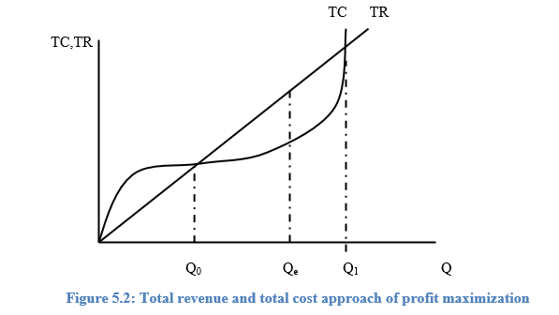
a) Total Approach (TR-TC approach)
a firm maximizes total profits in the short run when the (positive) difference between TR and TC is greatest.

Slide 9
b) Marginal Approach (MR-MC)
In the short run, the firm will maximize profit or minimize loss by producing the output at which MR = MC.
The following two conditions must met:
MR = MC
The slope of MC is greater than slope of MR; or
MC is rising (that is, slope of MC is greater than zero).

Slide 10
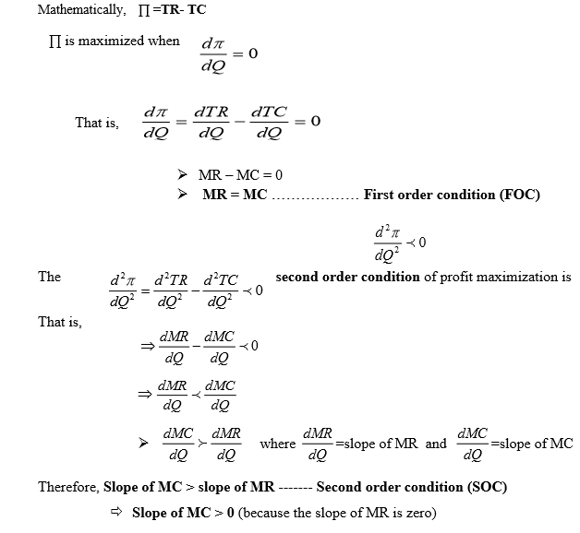

Slide 11
Whether the firm in the short- run gets
positive or
zero or
negative profit depends on the level of ATC at equilibrium.
Thus, depending on the relationship between price and ATC, the firm in the short-run may earn:
Economic profit
Normal profit or
Incur loss and
Decide to shut-down business

Slide 12
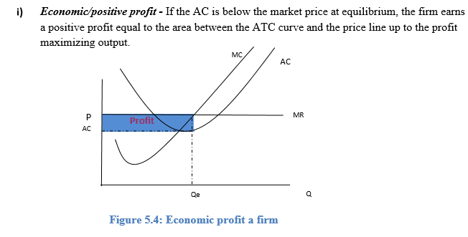

Slide 13
ATC
MC
MR
AC
MR
P=10
DD=P=MR=AR
AC=8
Q*=20
Q

Slide 14
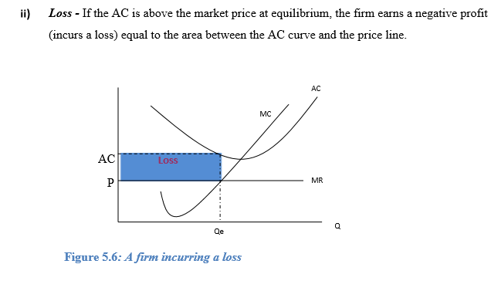

Slide 15
ATC
MC
MR
AC
MR
AC=12
P=10
DD=P=MR=AR
Q*=20
Q

Slide 16
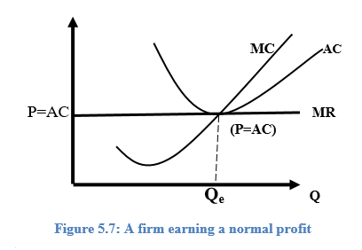
iii) Normal Profit (zero profit) or break- even point
- If the AC is equal to the market price at equilibrium, the firm gets zero profit or normal profit.

Slide 17
ATC
MC
MR
AC
MR
P=AC=10
DD=P=MR=AR
Q*=20
Q

Slide 18
iv) Shutdown point
The firm will not stop production simply because AC exceeds price in the short-run.
The firm will continue to produce irrespective of the existing loss as far as the price is sufficient to cover the AVC.
This means, if P is larger than AVC but smaller than AC, the firm minimizes total losses.
But if P is smaller than AVC, the firm minimizes total losses by shutting down.
Thus, P = AVC is the shutdown point for the firm.

Slide 19
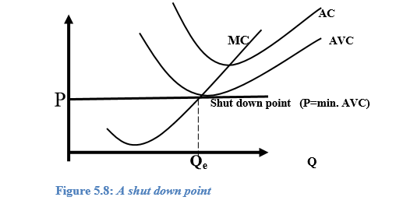

Slide 20
5.3 Monopoly market
5.3.1 Definition and Characteristics
Pure monopoly exists when a single firm is the only producer of a product for which there are no close substitutes.
Example: Local utilities
The main characteristics of this market structure include:
Single seller
A pure or absolute monopoly is a one firm industry.
2. No close substitutes
there are no good or close substitutes.
3. Price maker
control over price and the total quantity supplied.
Can change product price by changing the quantity of the product supplied.

Slide 21
4. Blocked entry
A pure monopolist has no immediate competitors because there are barriers, which keep potential competitors from entering in to the industry.
These barriers may be
economic,
legal,
technological etc.
entry is totally blocked.

Slide 22
5.3.2 Sources of monopoly
Legal restriction:
Some monopolies are created by law in public interest.
Such monopoly may be created in both public and private sectors.
E. g public utility sector, including postal service, telegraph, telephone services, radio and TV services, generation and distribution of electricity, rail ways, airlines etc… are public monopolies.

Slide 23
ii) Control over key raw materials:
control over certain scarce and key raw materials that are essential for the production of certain other goods.
iii. Efficiency:
a primary and technical reason for growth of monopolies is economies of scale.
The most efficient plant (probably large size firm,) which produces at minimum cost, can eliminate the competitors by curbing down its price for a short period and can acquire monopoly power.

Slide 24
iv) Patent rights:
Patent rights are granted by the government to a firm to produce commodity of specified quality and character.
or to use specified rights to produce the specified commodity or to use the specified technique of production.
Such monopolies are called to patent monopolies.

Slide 25
5.4 Monopolistically competitive market
Are the market in which there are many firms selling differentiated products.
It is the blend (mixture) of competition and monopoly.
The competitive element arises from the existence of large number of firms and no barrier to entry or exit.
The monopoly element results from differentiated products.
Example: Clothes, Shoes
This market is characterized by:

Slide 26
1. Differentiated product:
the product produced and supplied by many sellers in the market is similar but not identical in the eyes of the buyers.
There is a variety of the same product.
The difference could be in style, brand name, in quality, or others.
2. Many sellers and buyers:
there are many sellers and buyers of the product
but their number is not as large as that of the perfectly competitive market.
3. Easy entry and exit:
no barrier on new firms that are willing and able to produce and supply the product in the market.

Slide 27
4. Existence of non-price competition
Economic rivals take the form of non-price competition in terms of product quality, advertisement, brand name, service to customers, etc.
A firm spends money in advertisement to reach the consumers about the relatively unique character of its product and thereby get new buyers and develop brand loyalty.
Many retail trade activities such as clothing, shoes, soap, etc are in this type of market structure.

Slide 28
5.5 Oligopoly market
A. Few dominant firms
the number of firms is small enough that each firm recognizes the actions of other firms, implying that firms are mutually interdependent.
B. Entry barrier: there are considerable obstacles that hinder a new firm from producing and supplying the product.
The barriers may include economies of scale, legal, control of strategic inputs, etc.
C. Products may be homogenous or differentiated.
If the product is homogeneous, we have a pure oligopoly.
If the product is differentiated, it will be a differentiated oligopoly.
A special type of oligopoly in which there are only two firms in the market is known as duopoly.
Example: Steel, Automobiles

